Slide 1
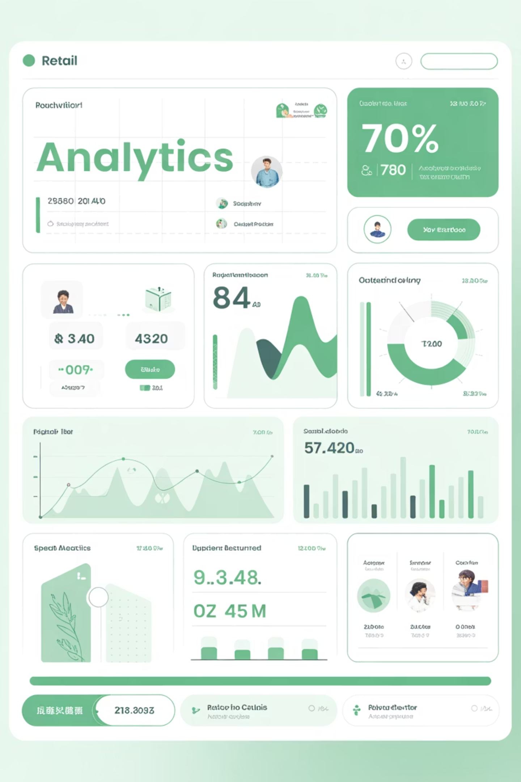
Customer Shopping Behavior Analysis
Transforming 3,900 transactions into strategic insights for data-driven profitability and targeted customer engagement.

Slide 2

PROJECT SCOPE
Analysis Overview
3,900 Transactions
Cross-category purchase data analyzed for comprehensive insights.
Strategic Focus
Product preferences, subscription behavior, and high-value segments.
Business Goal
Convert raw data into actionable strategies for improved profitability.

Slide 3

Dataset Profile
3,900
18
99.5%
Total Records
Data Columns
Completeness
Comprehensive transaction volume
Rich feature depth for analysis
Highly reliable dataset
37
Missing Values
Minor gaps in review ratings

Slide 4
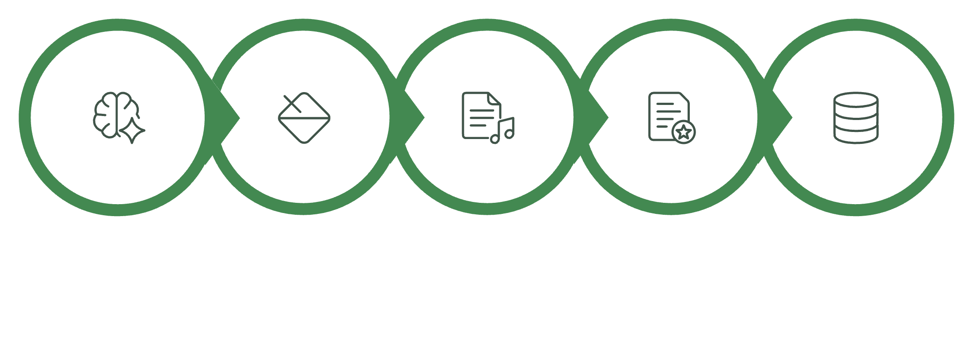

DATA ENGINEERING
Multi-Stage Refinement Process
Context-Aware Imputation
Resolved 37 missing review ratings using category-specific medians, preventing bias from global averages.
Feature Engineering
Created Age Grouping and Purchase Frequency metrics for deeper customer segmentation.
Data Audit
Intelligent Imputation
Refinement
Feature Engineering
DB Migration
Database Migration
Rigorous Python-based data preparation ensures accuracy and scalability for strategic analysis.
Integrated into Microsoft SQL Server for advanced querying and long-term scalability.

Slide 5
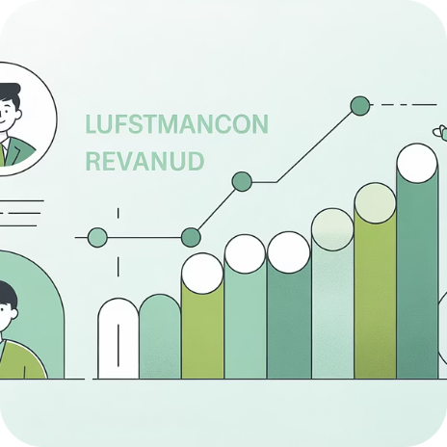
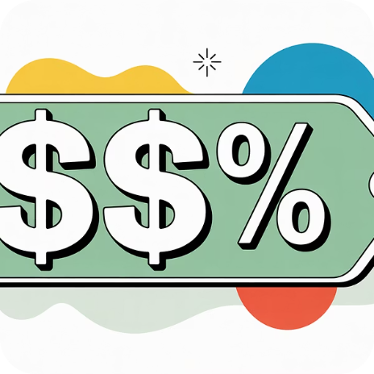

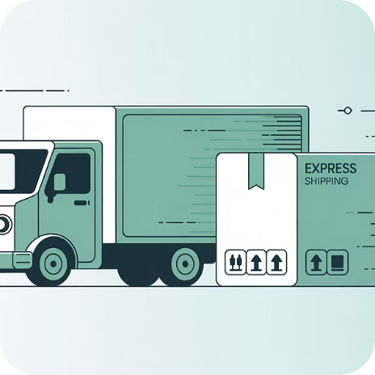
Key Business Insights from SQL Analysis
Revenue by Gender
High-Spending Discount Users
Top-Rated Products
Shipping Analysis
Male customers generated $157,890 vs. female customers at $75,191 in total revenue.
Gloves (3.86), Sandals (3.84), and Boots (3.82) lead in customer satisfaction.
Express shipping averages $60 per order vs. $58 for standard delivery.
Identified customers using discounts who still exceed average purchase amounts.

Slide 6
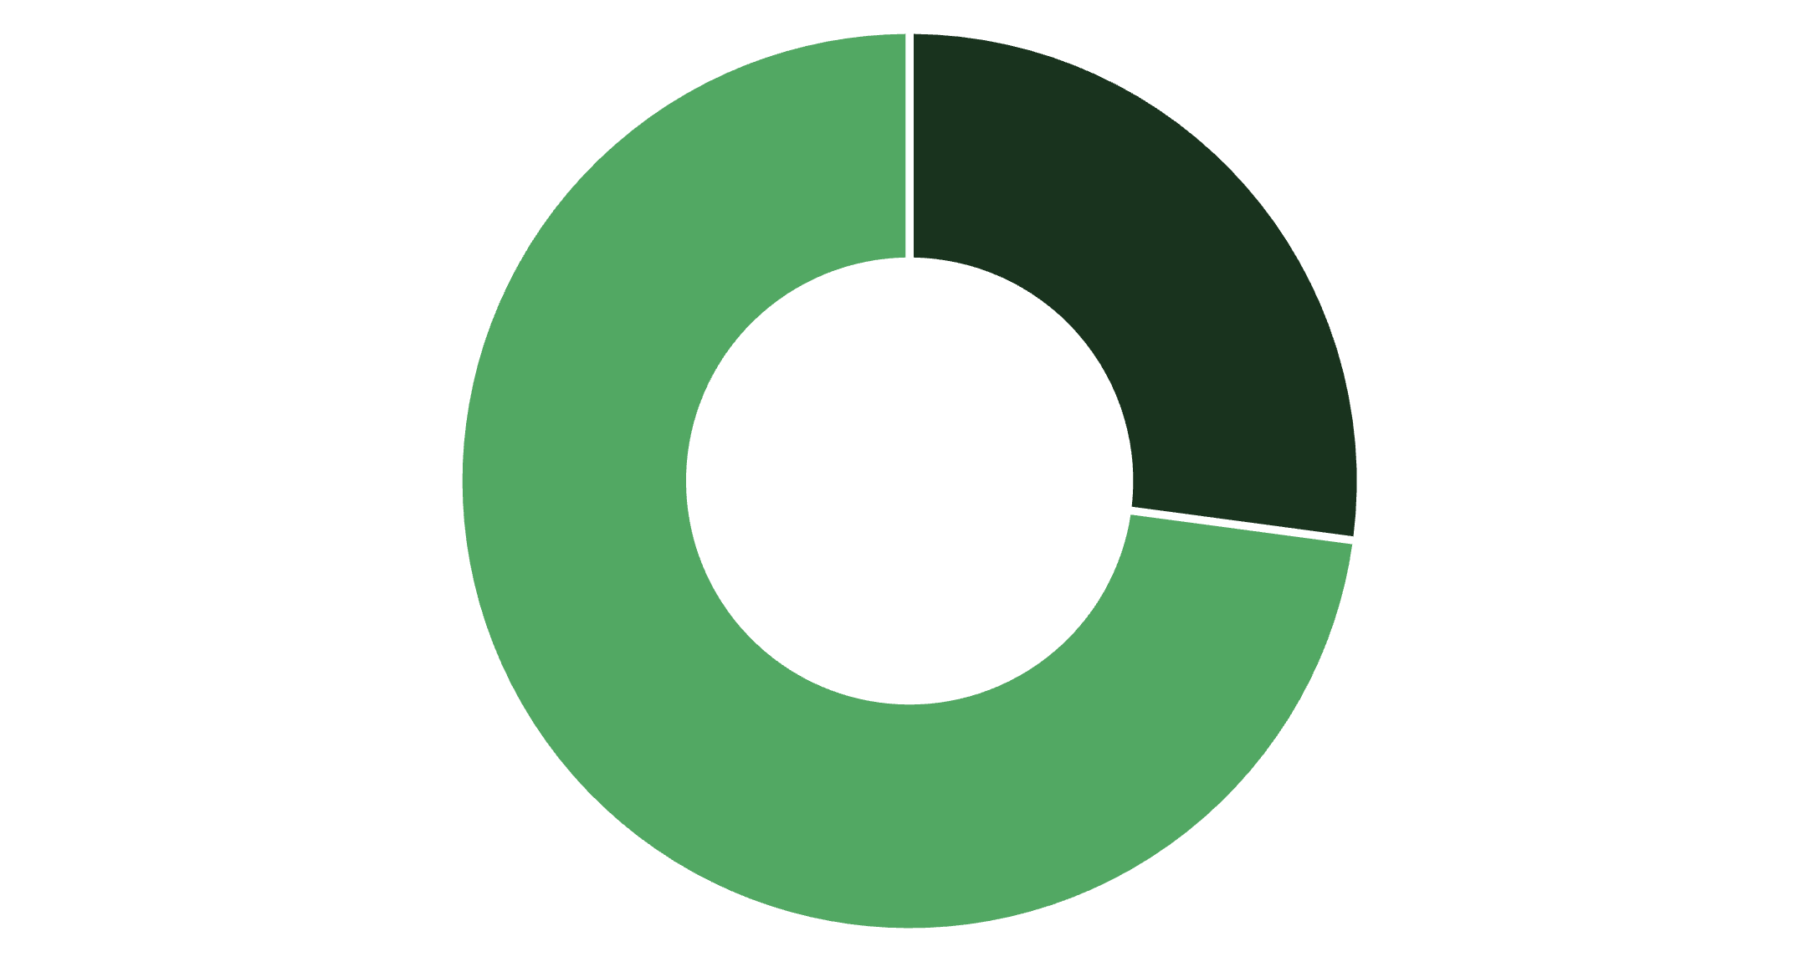
Subscription & Customer Segmentation
Subscription Insights
Only 27% of customers subscribe, yet both groups show similar $59 average spend. Significant opportunity for subscription conversion.
Customer Segments
Loyal: 3,116 customers (80%)
Returning: 701 customers (18%)
New: 83 customers (2%)
Subscribers
Non-Subscribers

Slide 7
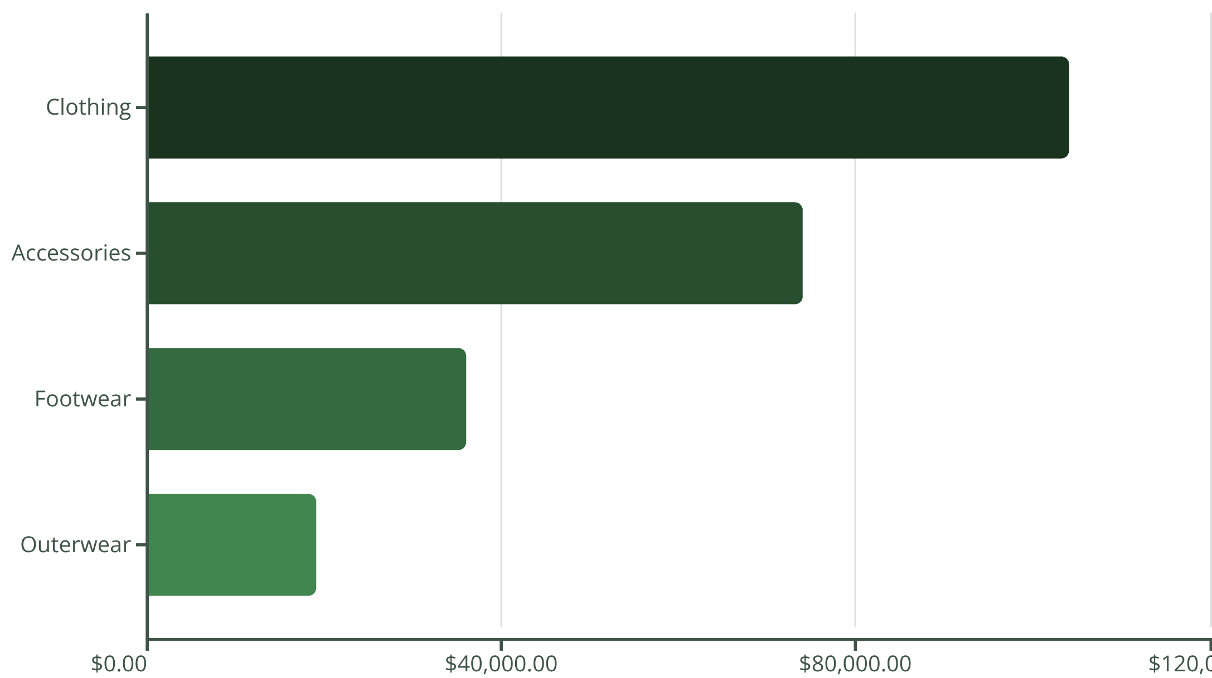
Revenue Performance by Category & Age
Category Leaders
Clothing dominates with $104K revenue and 1,737 sales, followed by Accessories at $74K.
Age Group Revenue
Young Adult: $62,143
Middle-Aged: $59,197
Adult: $55,978
Senior: $55,763

Slide 8

Power BI Dashboard
Interactive visualization platform enabling real-time exploration of customer behavior patterns, revenue trends, and segmentation insights across all key metrics.

Slide 9
STRATEGIC ACTIONS
Business Recommendations
1
2
3
4
Targeted Retention
Subscription Conversion
Margin Protection
Product Promotion
Deploy personalized loyalty campaigns for Loyal and Returning segments to increase lifetime value.
Target repeat buyers with 5+ purchases using exclusive incentives to join subscription program.
Reduce flat discounts on high-value customers; shift to value-add offers like free shipping.
Feature top 5 highest-rated products in marketing to leverage customer satisfaction.

Slide 10
Next Steps
Implementation Priority
01
02
Focus on subscription conversion and targeted retention for immediate revenue impact.
Demographic Allocation
Shipping Incentives
Shift marketing budget toward age groups and genders generating highest revenue.
Offer free express shipping on orders above average spend to increase basket size.
03
Continuous Monitoring
Track KPIs through Power BI dashboard for ongoing optimization.

